Slide 1
ISS : INTELLIGENT SURVEILLANCE SYSTEM
An IOT based intruder detection system based on object and emotion recognition

Slide 2

ISS : INTELLIGENT SURVEILLANCE SYSTEM
by
AVILIKONDA PRAVEEN KUMAR
(22001F0005)
Under the guidance of
Dr. P. CHENNA REDDY M.Tech., Ph.D
Professor
DEPARTMENT OF COMPUTER SCIENCE AND ENGINEERING
JAWAHARLAL NEHRU TECHNOLOGICAL UNIVERSITY ANANTAPUR
COLLEGE OF ENGINEERING
(Autonomous)
ANANTHAPURAMU-515002
ANDHRA PRADESH
2023 - 2024

Slide 3
contents
INTRODUCTION
EXISTING SYSTEM
DRAWBACKS
PROPOSED SYSTEM
ADVANTAGES
BLOCK DIAGRAM
MODULES
SOFTWARE SPECIFICATIONS
HARDWARE SPECIFICATIONS
CIRCUIT DIAGRAM
ALGORITHMS
OBJECT AND EMOTION DETECTION USING YOLO

Slide 4
Introduction
The Intelligent Surveillance System is an IOT device designed to revolutionize the way security is managed, offering a comprehensive solution that enhances safety, efficiency, and situational awareness throughout the entire surveillance lifecycle.
The Intelligent Surveillance System offers advanced detection and analysis capabilities, allowing for the automatic identification of security threats, suspicious behavior, and anomalous activities in real-time.

Slide 5
Existing system
Existing Surveillance systems leverage a combination of sensors, surveillance technology, and alarm systems to detect, deter, and respond to security threats effectively.
These systems play a crucial role in protecting assets, premises, and individuals against unauthorized access, theft, vandalism, and other security risks.

Slide 6
DRAWBACKS
Limited Intelligent features.
Lack of Real-time screening capabilities.
False Alarms.
Lack of Remote Management features.

Slide 7
Proposed system
The proposed system provides Real-Time Screening capabilities for Real-Time Intruder detection.
Reduces false Alarms by identifying Intruders based on Object and Emotion recognition.
Provides Remote Management features.
The proposed system uses trained ML algorithms to differentiate Intruders from normal people.

Slide 8
ADVANTAGES
Remote monitoring.
Reduced false alarms.
Real-time screening.
Enhanced intruder detection.

Slide 9
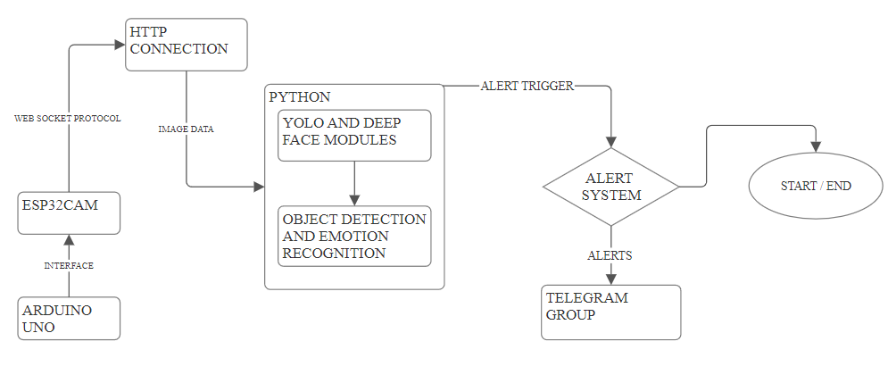
BLOCK DIAGRAM:

Slide 10
MODULES
1. Live Surveillance:
- 1.1 Provides users with live video feeds from surveillance cameras.
- 1.2 Allows users to select the live surveillance option for real-time monitoring.
2. Object Recognition:
- 2.1 Conducts real-time object detection in the live video feeds.
- 2.2 Enables users to select object recognition for identifying various objects
in the surveillance footage.

Slide 11
MODULES:
3. Emotion Detection:
- 3.1 Analyzes facial expressions and emotions in real-time from the live video feeds.
- 3.2 Allows users to select emotion detection for identifying emotions displayed
by individuals in the surveillance footage.
4. Alert System:
- 4.1 Triggers alerts based on detected objects and emotions in the live video feeds.
- 4.2 Notifies users promptly through email, SMS, or mobile apps upon
detecting concerning objects or emotions.

Slide 12
SOFTWARE SPECIFICATIONS:
Software Specifications:
Technology : Python, C++
Libraries : YOLO, OPEN CV, DEEPFACE, TENSORFLOW, MATPLOTLIB
Version : Python 3.6, C++
IDE : Arduino IDE, VS CODE

Slide 13
HARDWARE SPECIFICATIONS:
Hardware Specifications:
BOARDS : ARDUINO UNO, ESP32 CAM
RAM : 8 GB
Processor : AMD RYZEN R5
Hard Disk : 32 GB

Slide 14
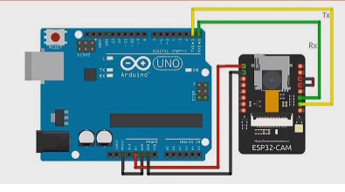
circuit Diagram:

Slide 15
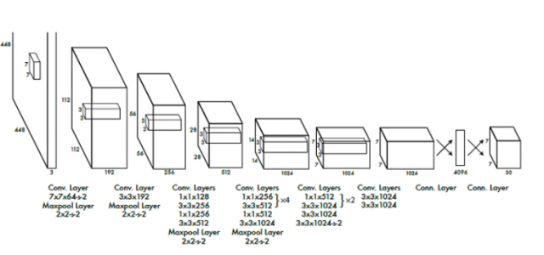
ALGORITHMS:
YOLO (You Only Look Once) is a deep learning algorithm for real-time object detection. It processes entire images in a single pass through a convolutional neural network (CNN), dividing them into a grid and predicting bounding boxes and class probabilities for objects. This simultaneous prediction enables real-time performance. YOLO uses non-maximum suppression to filter redundant detections, outputting the most confident predictions. Its efficiency and accuracy make it ideal for applications like surveillance, autonomous vehicles, and video analysis.

Slide 16
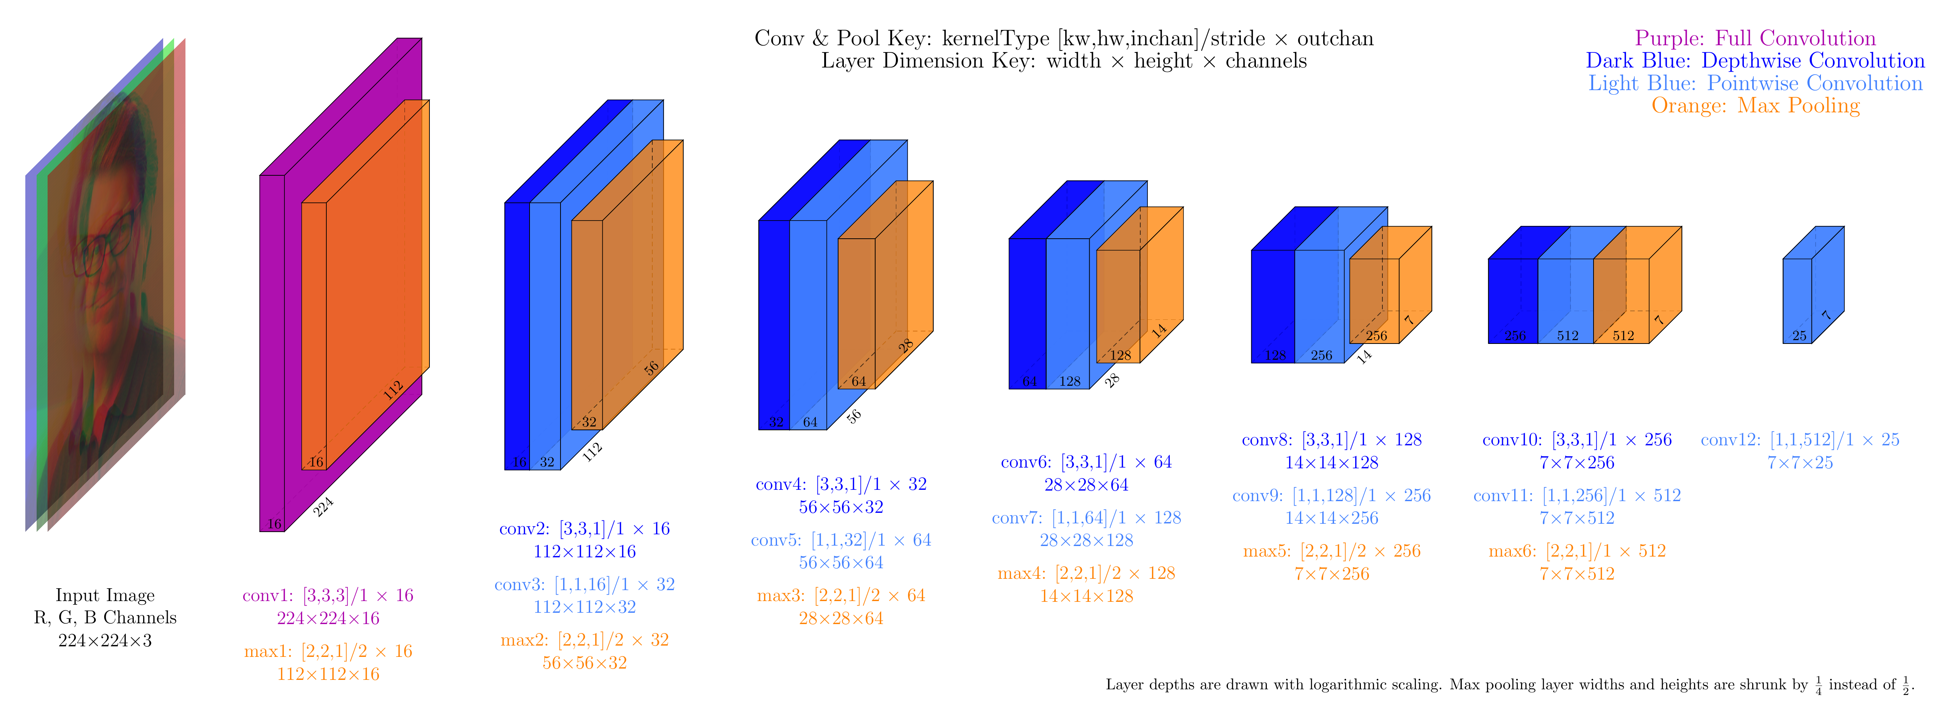
Object and Emotion Recognition using Yolo:

Slide 17
THANK YOU

